Slide 1
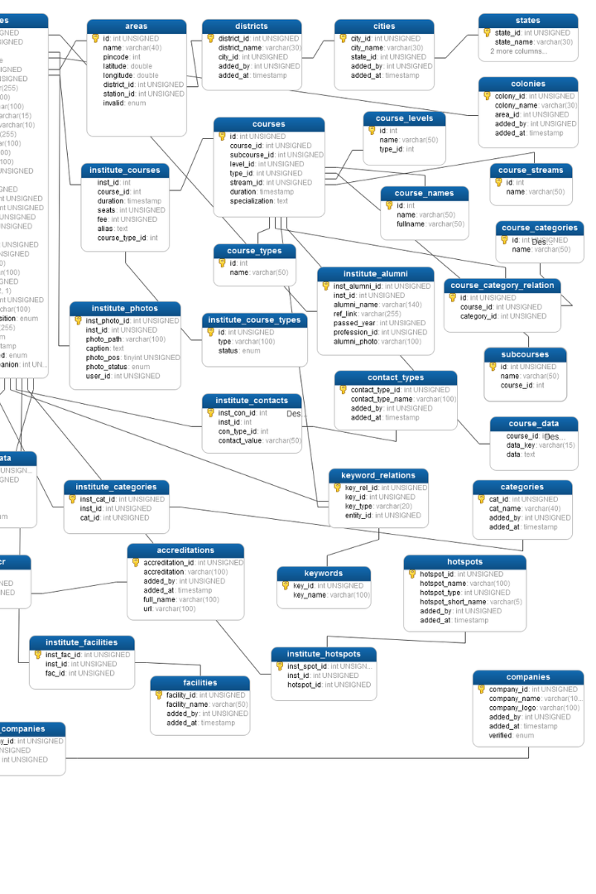
Certified Java Full Stack Professional - Capgemini College Connect
Introduction to Languages in MySQL
In MySQL, languages are:
Those who allow the database users to read, modify, delete and store data in the database systems.
Of 4 different types
- Bhakti Menkar
Batch:2023-10427
Enrollment No: EBEON0923756263

Slide 2
Types of Languages
1
DDL
2
DML
Data Definition Languages allow users to create, modify, and destroy the schema of database objects.
Data Manipulation languages allow database users to change the existing data of the table
3
DCL
4
TCL
Data Control Languages allow DBA to manage the rights and permissions on the data in the database.
Transaction Control languages maintain the SQL operations within the database. It also saves the changes made by the DML commands.

Slide 3
DDL (Data Definition Language)
CREATE Command
This DDL command allows us to create the new table, function, stored procedure, and other database objects.
CREATE TABLE Mobile_Details (
Mobile_Number INT NOT NULL,
Mobile_Name Varchar(50),
Manufacturing_Year INT NOT NULL,
Mobile_Cost INT );
TRUNCATE Command
This DDL command allows the database users to remove all the existing records from the table.
TRUNCATE TABLE Mobile_Details;
RENAME Command
This DDL command allows the users to change the name of the existing table.
RENAME Old_Table_Name TO New_Table_Name;
RENAME Mobile_Details TO Mobile_Records;
ALTER Command
This DDL command allows us to modify the structure of database objects.
ALTER TABLE Mobile_Details ADD Mobile_Color Varchar (50);
DROP Command
This DDL command allows us to remove the table definition and data from the SQL systems.
DROP TABLE Mobile_Details;

Slide 4
DML (Data Manipulation Language)
SELECT Command
This DML command allows us to access the stored records from the tables. We can also use the condition in the SELECT command for accessing the particular rows.
SELECT * FROM Mobile_Records;
UPDATE Command
This DML command allows the database users to change the existing record or rows in the tables.
UPDATE Mobile_Records SET Manufacturing_Year = 2022 WHERE Mobile_Color = 'White';
DELETE Command
This DML command allows the database users to delete a particular record or row from the tables.
DELETE FROM Mobile_Records WHERE Manufacturing_Year = 2019;
INSERT Command
This DML command allows the database users to insert the new record or rows in the tables.
INSERT INTO Mobile_Records (Mobile_number, Mobile_Name, Manufacturing_Year, Mobile_Cost, Mobile_Color) VALUES (95872, Apple, 2020, 95000, Black);

Slide 5
DCL (Data Control Language)
GRANT Command
This DCL command allows the database administrator to give permissions to the user for retrieving the data.
Syntax of Grant DCL Command:
GRANT Name_of_Privilege ON Object TO User;
Example of Grant Command:
The following query grants the SELECT privilege on the Mobile_Records table:
GRANT SELECT ON Mobile_Records TO 'OnePlus'@'localhost';
REVOKE Command
This DCL command allows the database administrator to remove all the permissions applied by the GRANT DCL command.
Syntax of REVOKE DCL Command:
REVOKE Name_of_Privilege ON Object FROM User;
Example of REVOKE Command:
The following query removes the SELECT privilege from the Mobile_Records table:
REVOKE SELECT ON Mobile_Records FROM 'OnePlus'@'localhost';

Slide 6
TCL (Transaction Control Language)
COMMIT Command
This command allows the database users to save the operations in the database.
Syntax of Commit command:
COMMIT;
Example of Commit Command:
The following statements delete the record from the Mobile_Record table and commit the changes in the database:
DELETE FROM Mobile_Records WHERE Mobile_cost = 20000;
COMMIT;
Rollback Command
This command allows the database users to restore the transactions to that state which was last committed.
Syntax of Rollback command:
ROLLBACK;
Example of Rollback Command:
The following statements delete the record from the Mobile_Record table and rollback the changes in the database:
DELETE FROM Mobile_Records WHERE Mobile_cost = 20000;
ROLLBACK;

